Slide 1


Anarchy
Real time strategy – 2d game
Notes:
The game is considered a real time strategy. The subset of the genre is considered Tower Defense.
The main components include a main player castle/home base with the ability to expand, build, destroy, block, and attack the enemies.
The game is composed of a top-down camera that can navigate around a map. The player will have the ability to view all portions of the map, and decide where to place his/her units.
Layout of the game gains it’s inspiration from many strategy games like Clash of Clans, Age of Empires, Kingdom Rush, Mad Max Movies, Boom Beach, etc…
Story: You are a survivor of the great “Fall of 2065”. ”. After years of unchecked over population, and Humans ravaging the natural resources of planet Earth, a series of events led to the fall of all governmental powers and led to utter chaos. Low food and water alongside harsh weather changes due to global warming led to the demise of much of Earth’s human population. You are now tasked to survive in a world where there are no rules or laws, survive as-long as you can and maybe you can re-civilize the Earth.
- Credit goes to David!

Slide 2
SYSTEM REQUIREMENTS
Focused on PC Gamers
Graphics Card / Small amounts of flashes, and filters
Sound Card
Mouse/Keyboard – No function for controller (yet)
Possible port for Mobile/Tablet

Slide 3
Game Controls
Mouse:
Left/Right Click
Dynamic movement of mouse
Camera movement
Keyboard:
W, A, S, D
Undecided hotkey to bring up HUD, Upgrade Tree, Resource Management
ESC to bring up the Main Menu

Slide 4
Gameplay/mechanics
Idea Surrounded by “ Tower Defense “. Implementation will include but not limited to:
Main base for player to defend
Wave Attacks/Survival
Placement of “towers/turrets” to defend home base
Ability to upgrade
Reward System
Currency, or build system
Ledger of available unlocks
Resource System

Slide 5
Re-playability
To increase re-playability of the game we increase the difficulty which allows the player to enjoy complexity of waves and become engaged.
We are also going to include “cool-down” periods to allow the player to breathe and expand their base as needed. The game is designed for continuous play (with room to expand on enemy concepts and different map designs). There is no true ending other than the player’s base being destroyed.
We currently have no sequels planned at this time.

Slide 6
Asset List
Music:
Composition of music will be determined based on the musicians provided by NORCO College. A specific theme (post-apocalyptic) is what the team is looking for. We have provided a small sound sample of what our game is moving towards. Potential music will have a dark themed that matches to the movie of Mad Max, or Walking Dead.
Our game will include small sound bites when a certain objects being built, or when an object is being interacted with. We want to make sure the sound keeps true with the theme.
Background music will be low enough to where the player can focus on the game, and NOT feel overwhelmed with blaring music.

Slide 7
Asset list
Art: So far we have created preliminary models for the game. This includes base, expansions, enemies, etc… These include:

Slide 8
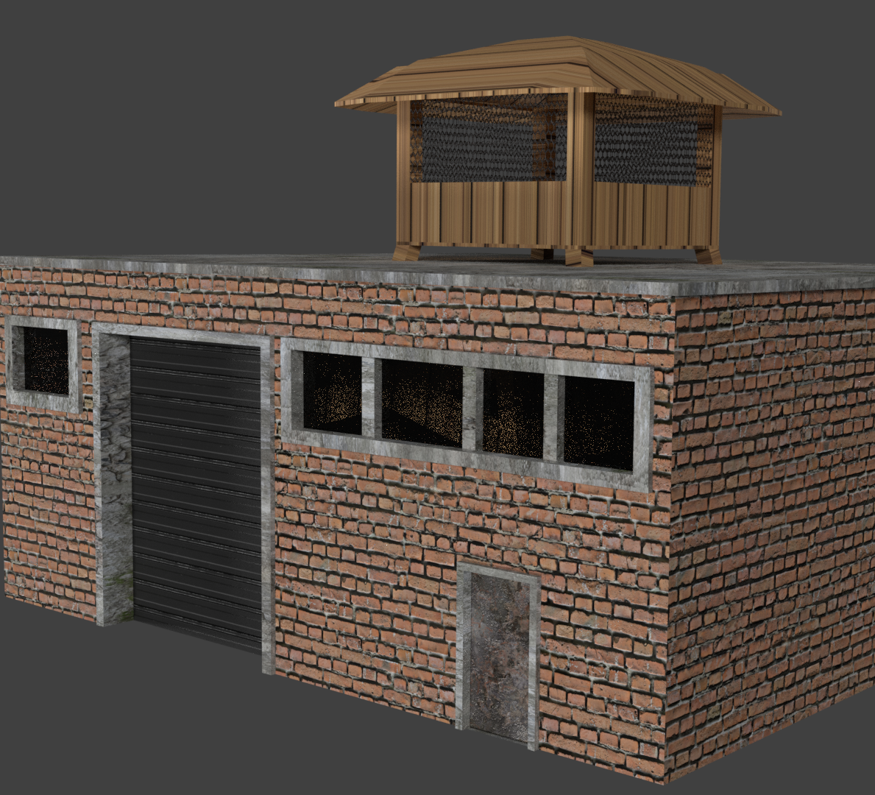
Home base

Slide 9
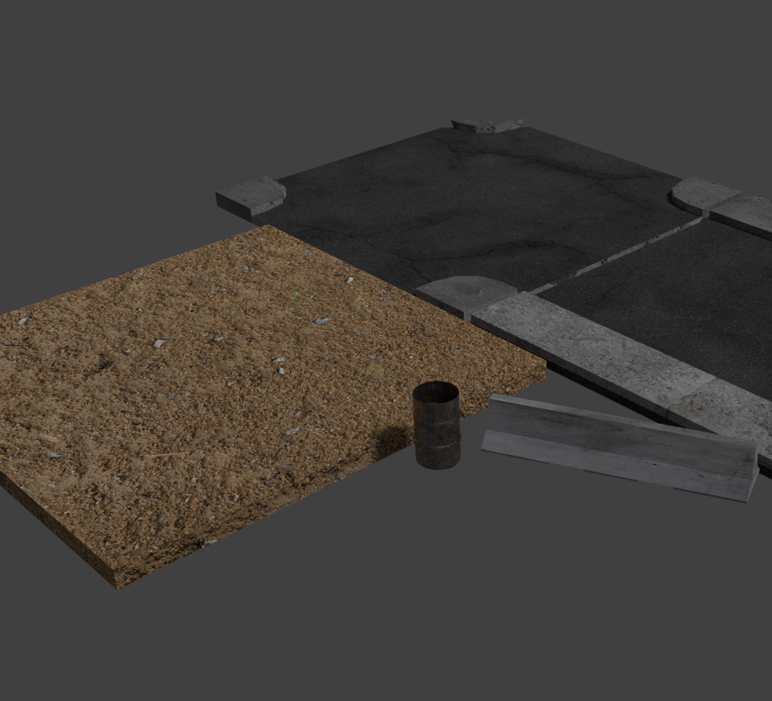
Enemy walkway turret placer

Slide 10
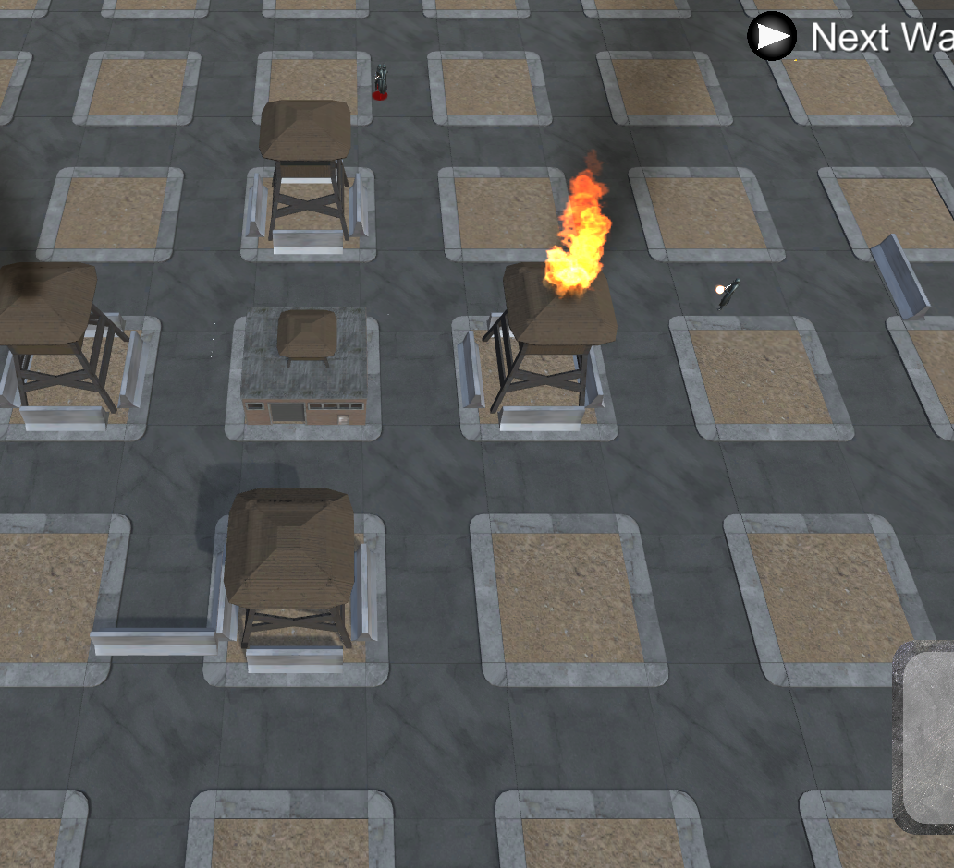
Map design

Slide 11
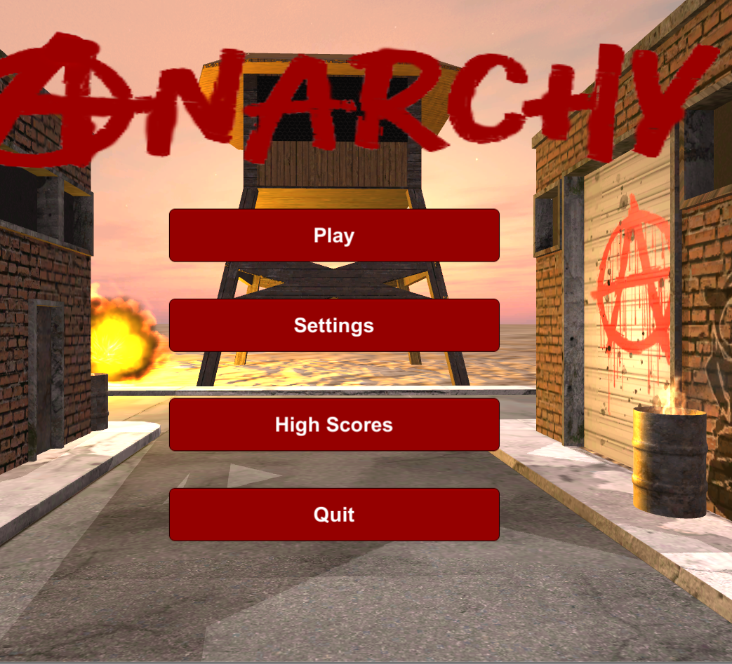
Main menu ui

Slide 12
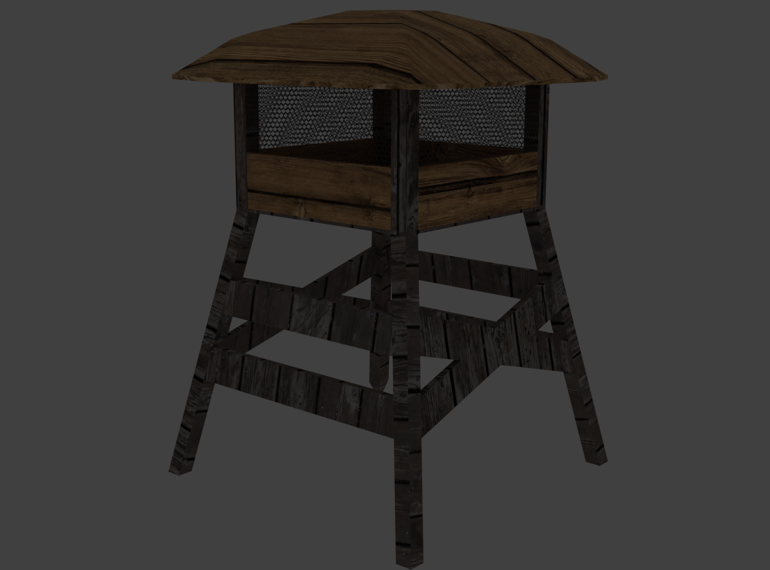
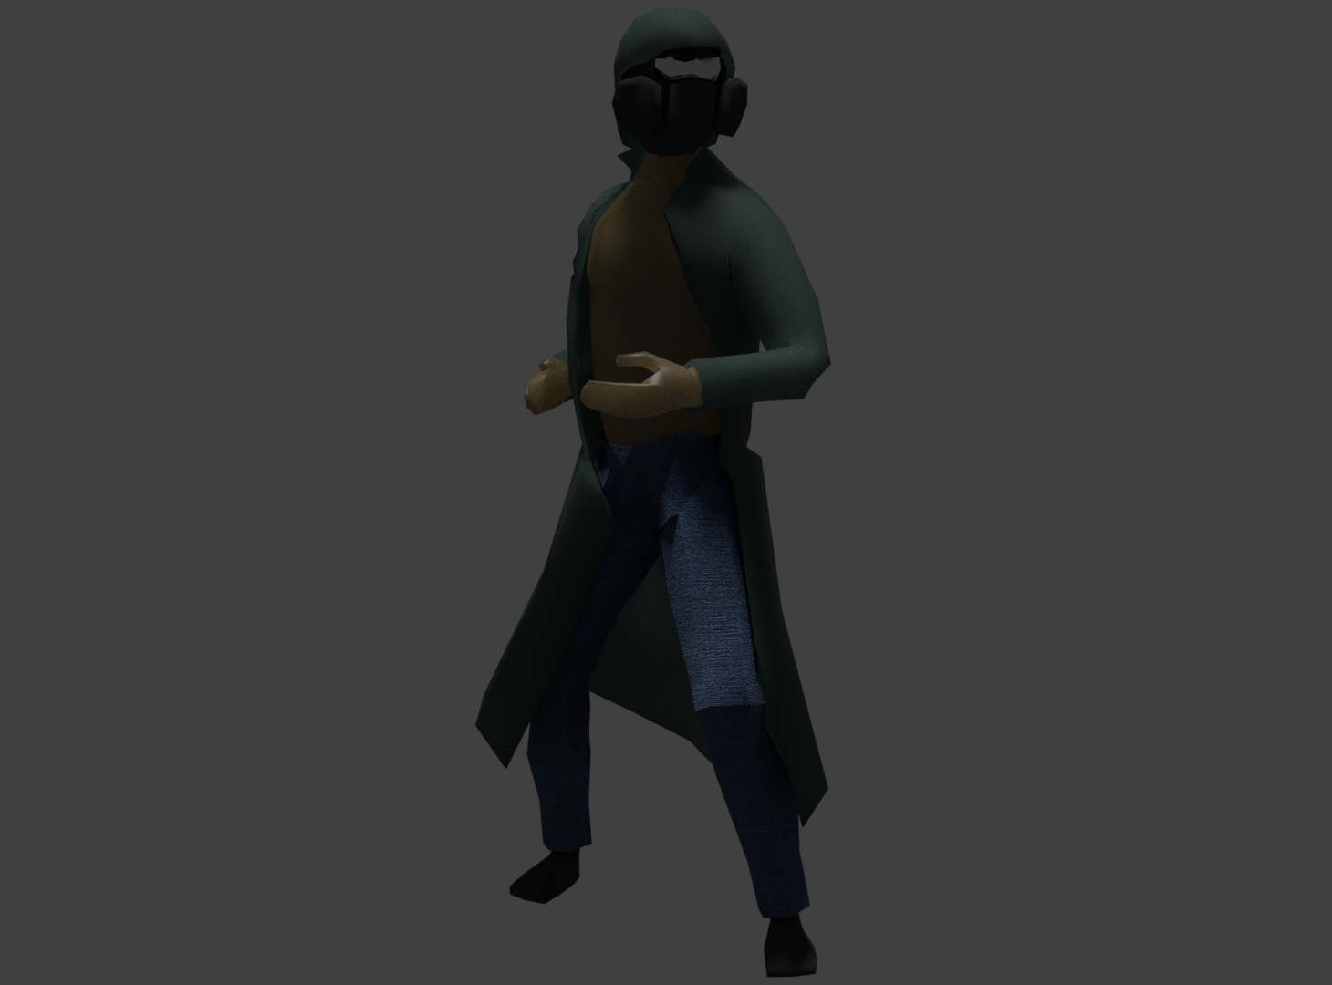
Tower expansion & enemy model

